Slide 1
2-Player Mancala
Adversarial Game
Ionescu Andrei, 507

Slide 2
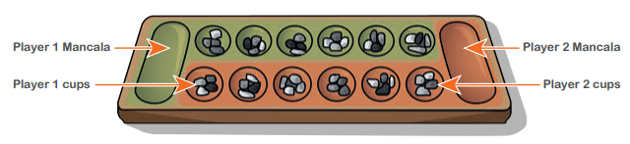
2-Player Mancala Game Description
A small introduction to some game concepts:
The game is played in two people, each taking turns;
The board consists of two sides for each player;
The spots on the board are called cups and the sidelines are called mancala;
Each player owns a side of the board and the mancala on its right side;
The board’s cups are initially filled with four pebbles;
During a player’s turn they can select a cup and place its pebbles, in counter-clockwise manner, one by one, in the following cups and mancala they own;
The game ends when either side is empty and the winner is the one who has most pebbles in their mancala;
Source: https://www.worldvision.org.uk/media/sicflofy/worldvision_kidsactivity_play_mancala.pdf

Slide 3
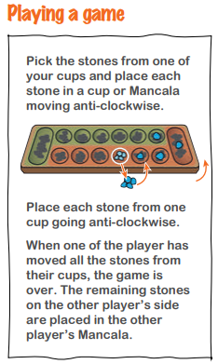
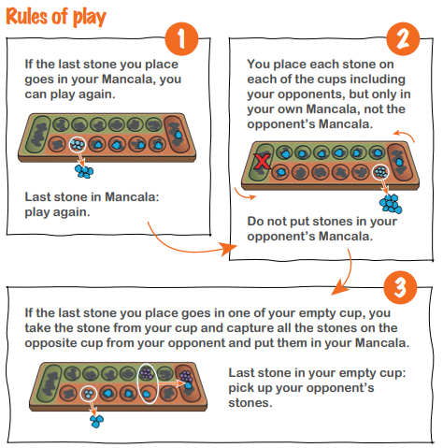
2-Player Mancala Game Description
Source: https://www.worldvision.org.uk/media/sicflofy/worldvision_kidsactivity_play_mancala.pdf

Slide 4


Game Implementation

Slide 5
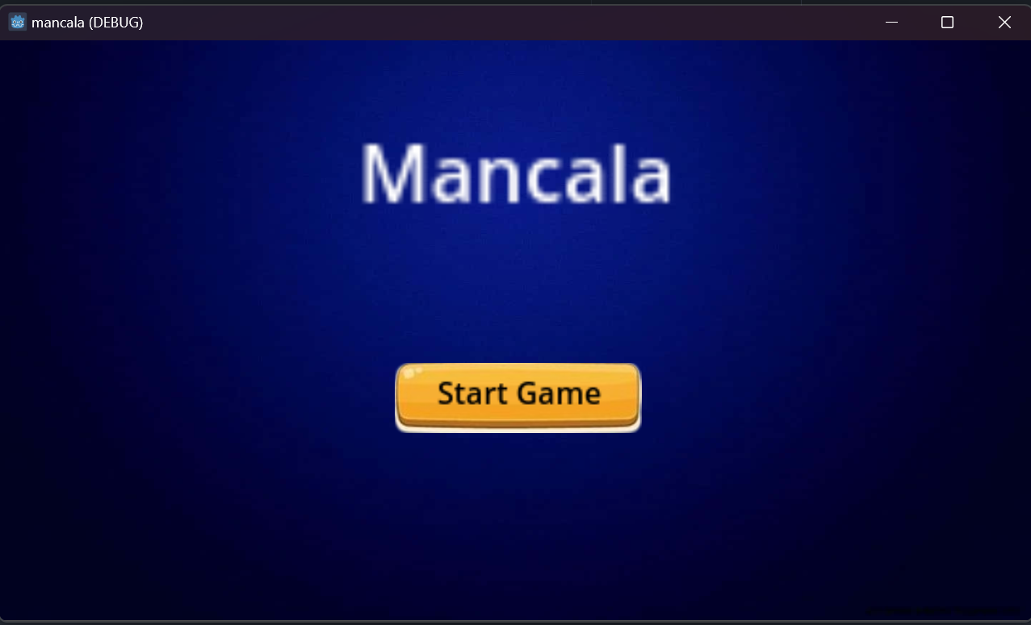
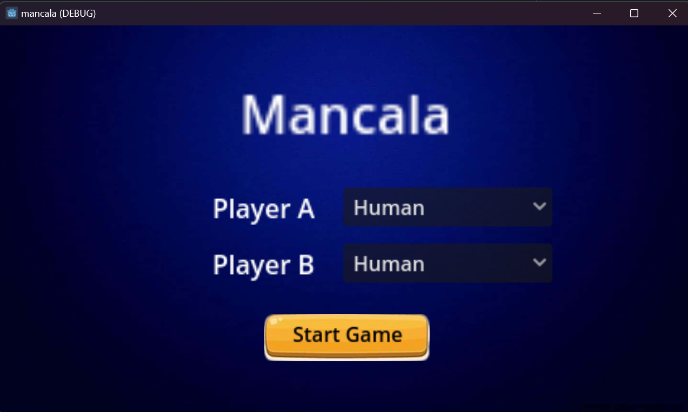
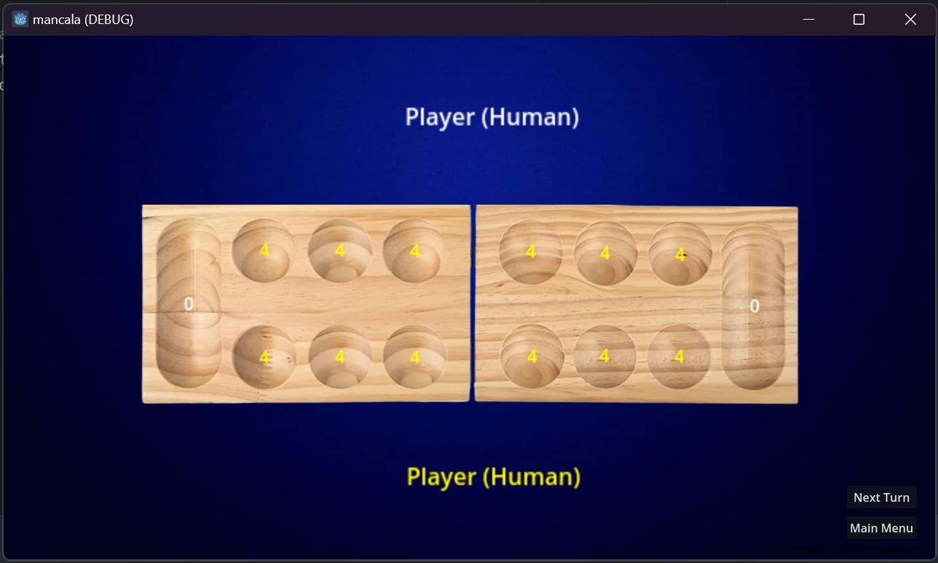
Game Implementation

Slide 6
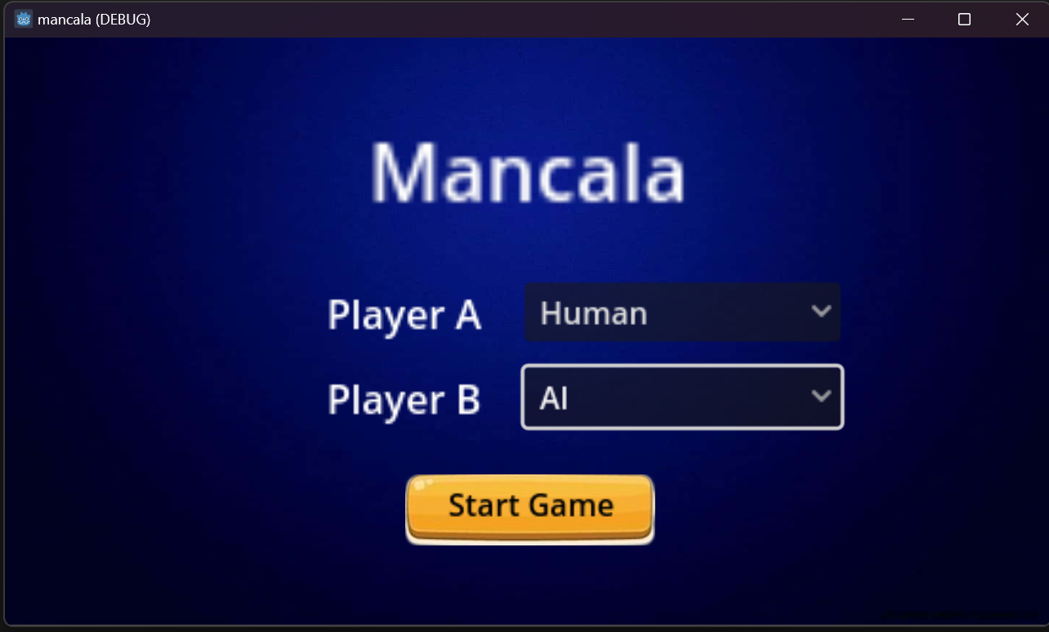
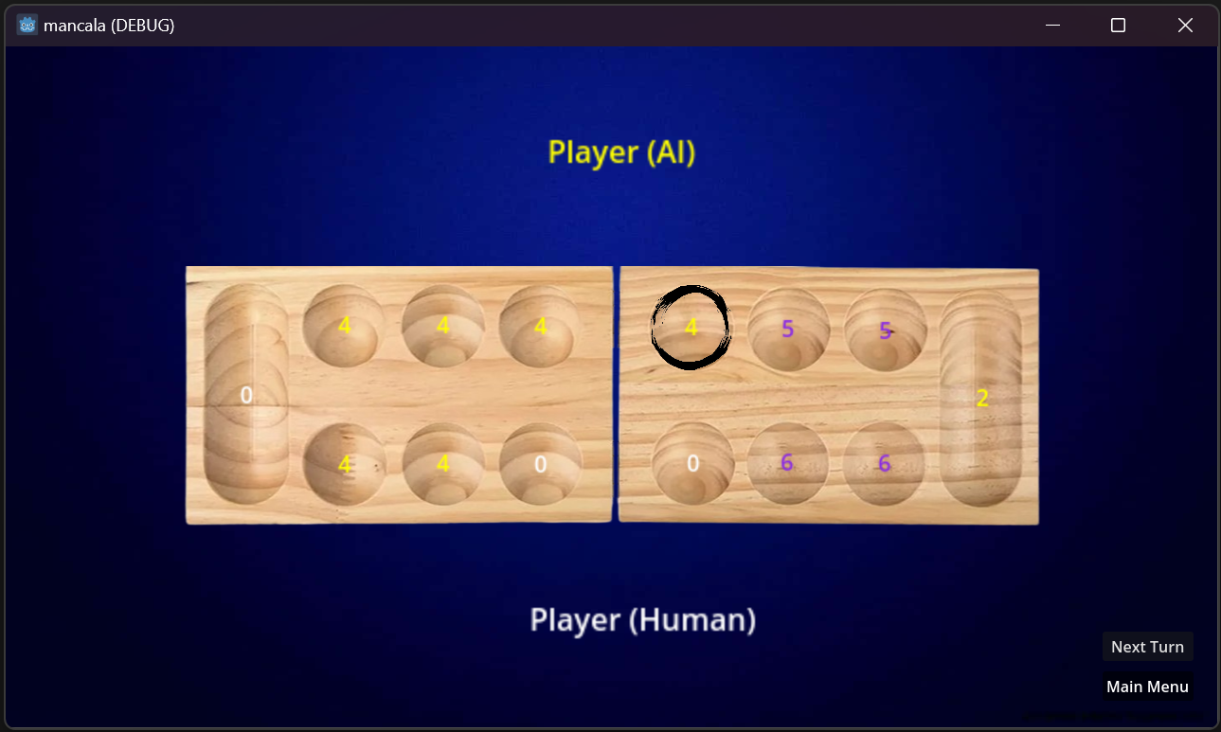
Game Implementation

Slide 7
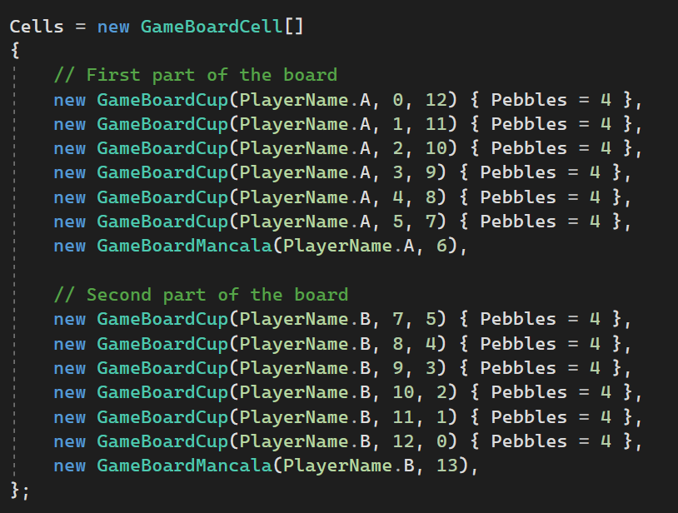
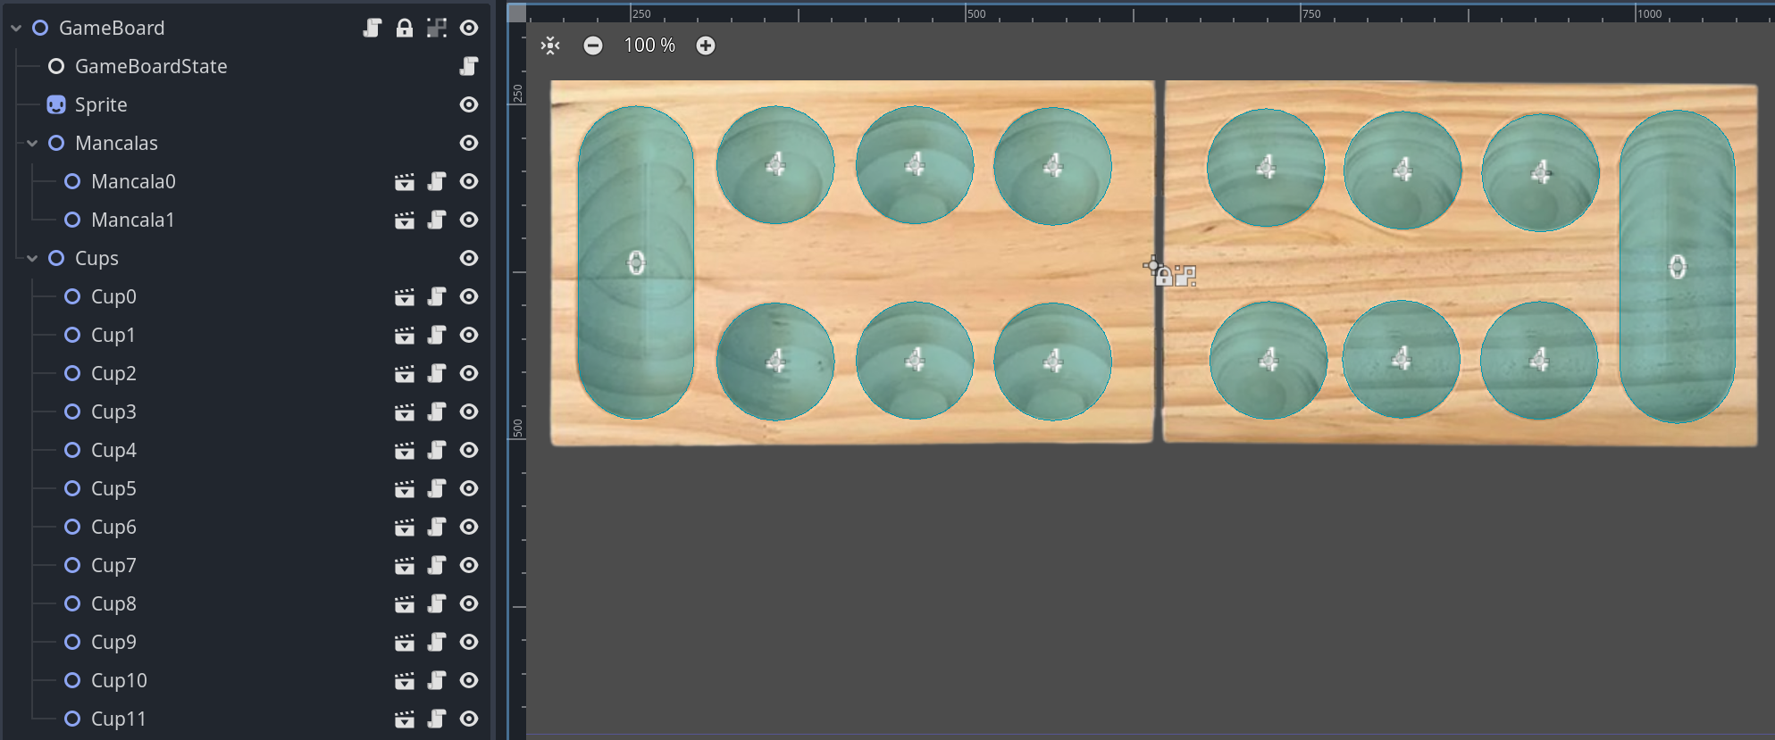
Game Representation

Slide 8
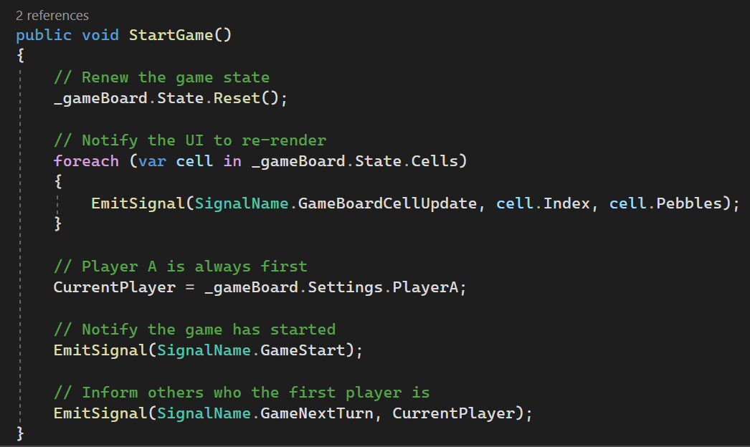
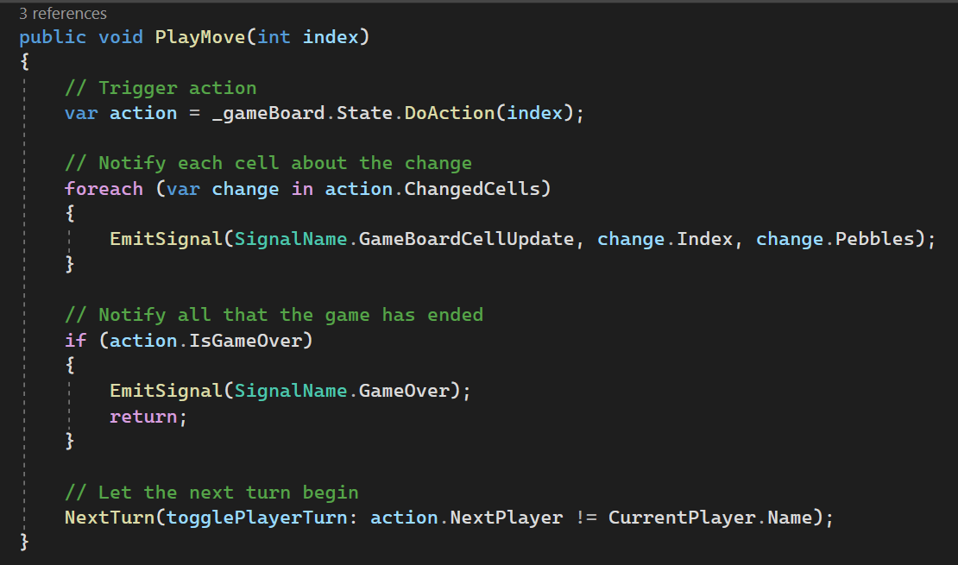
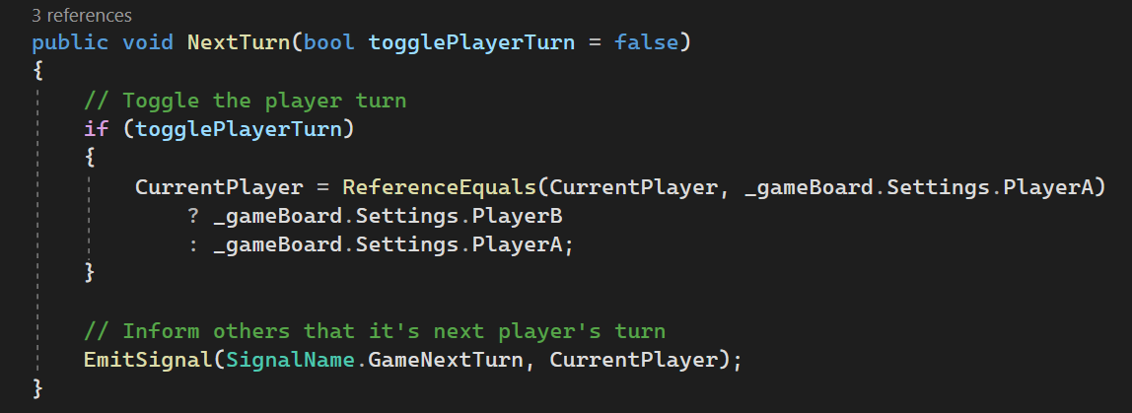
Game Representation

Slide 9
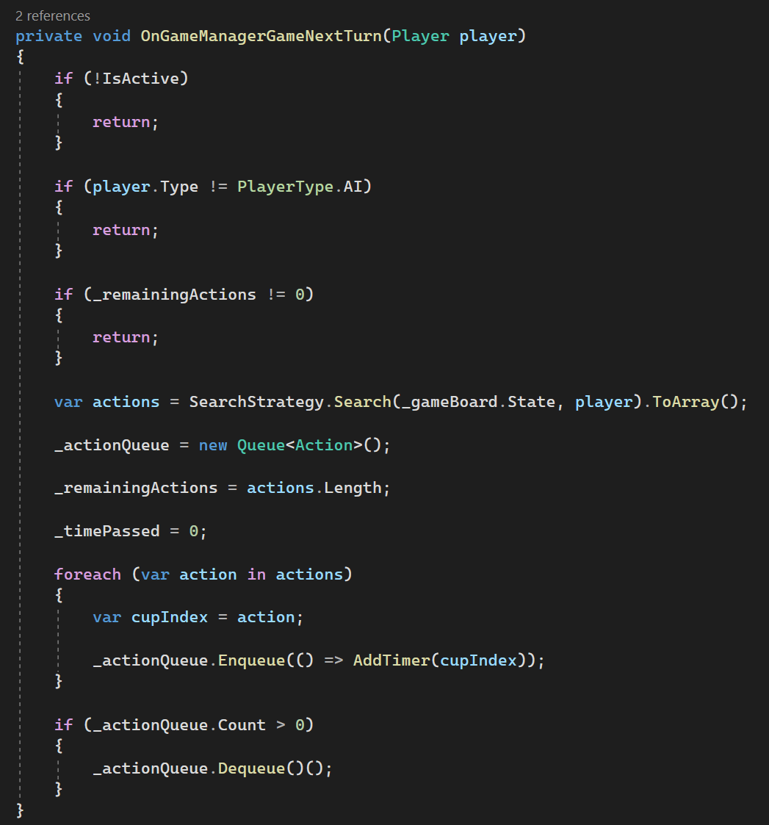
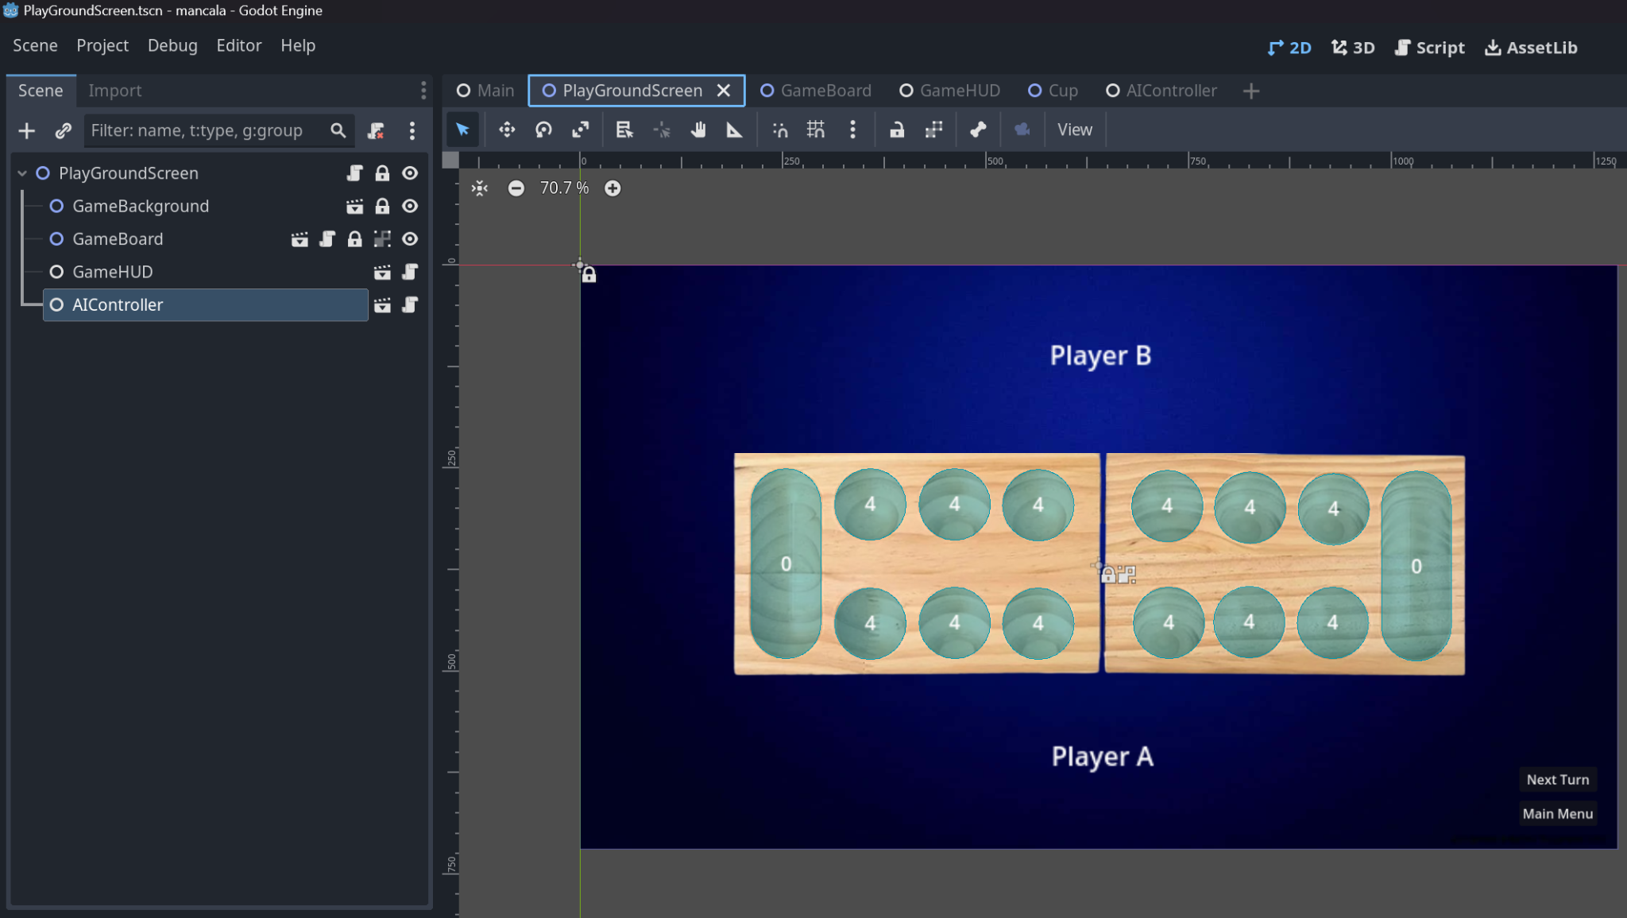
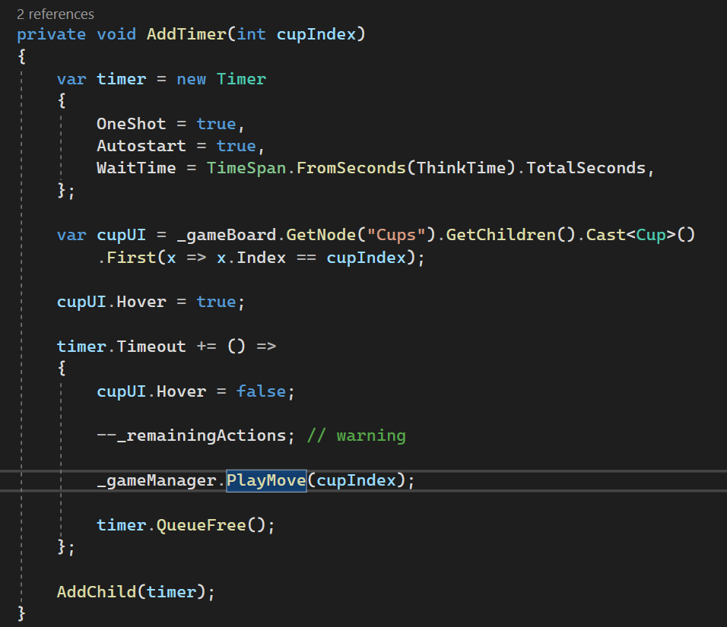
AI Implementation
Each turn the GameManager emits a “Next Turn” notification and when the player playing is the Agent it starts from the current GameBoard State and applies Heuristic Alpha-Beta Tree Search to find a set of valid moves.

Slide 10
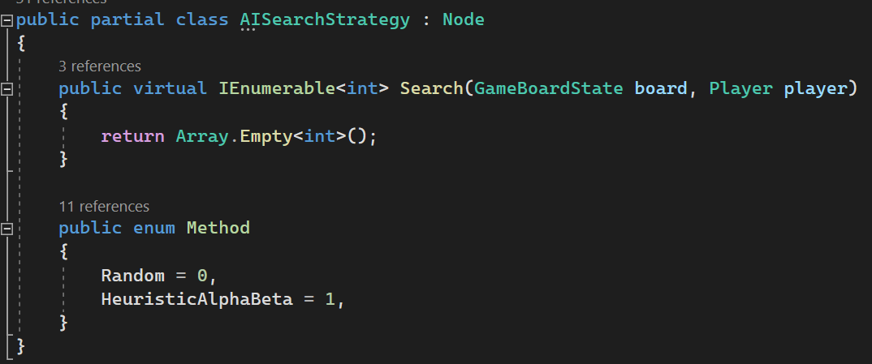
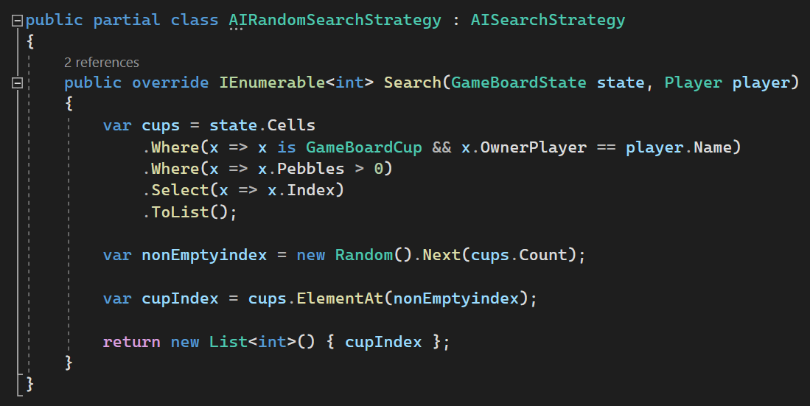
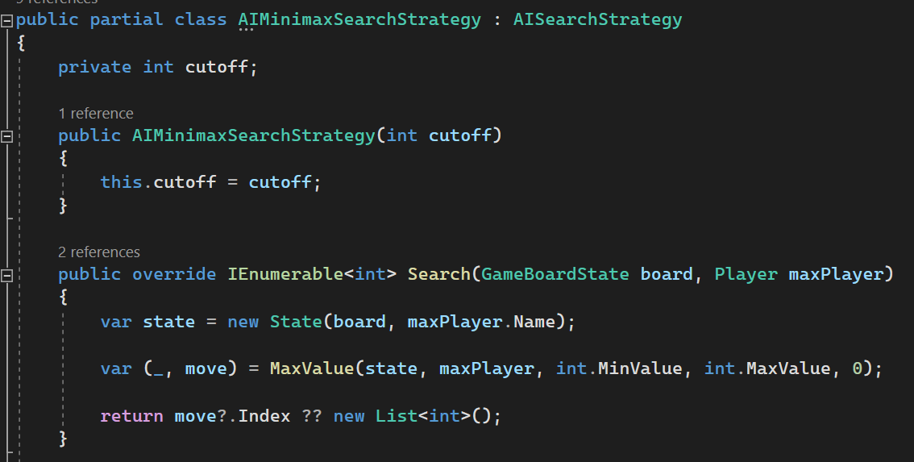
AI Implementation

Slide 11
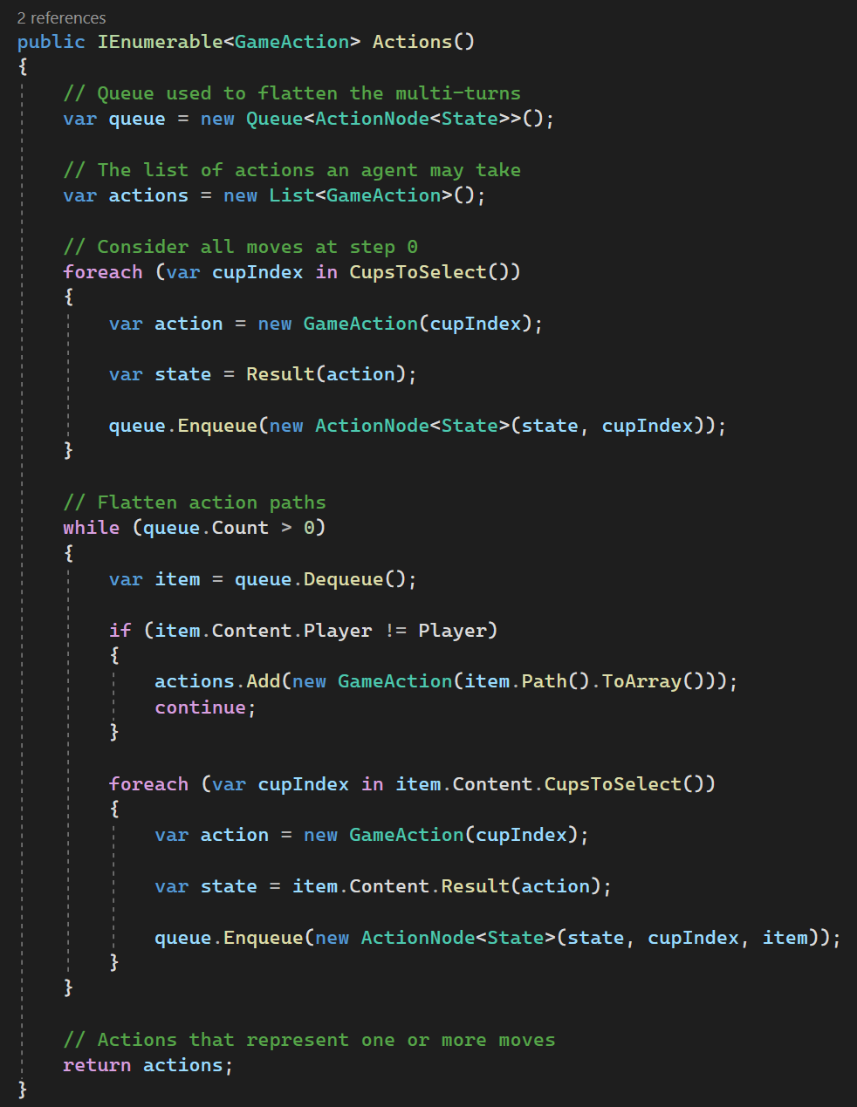
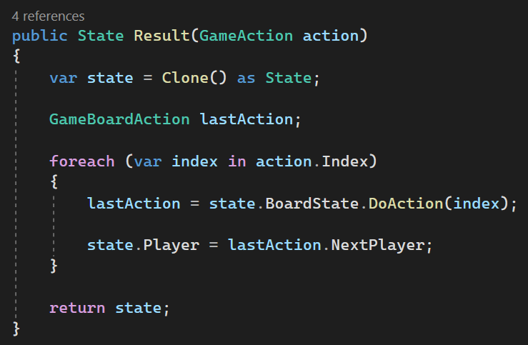
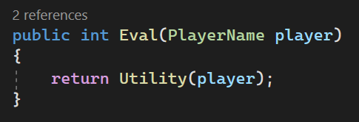
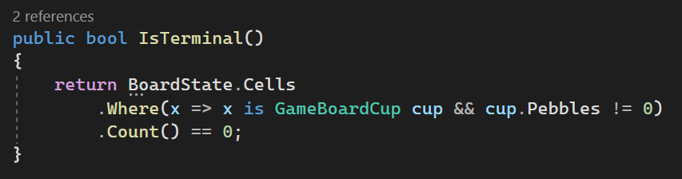
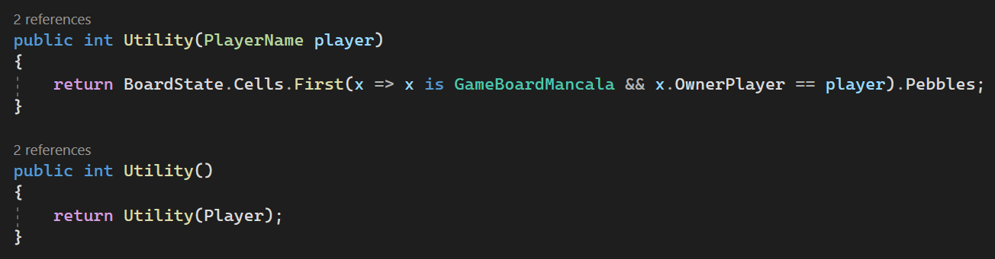
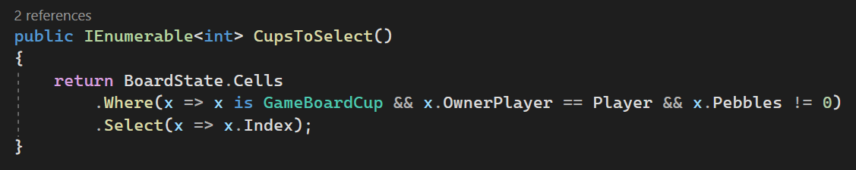
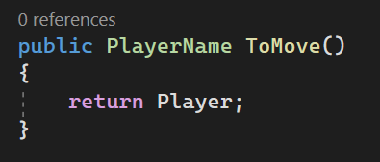
Search Representation

Slide 12
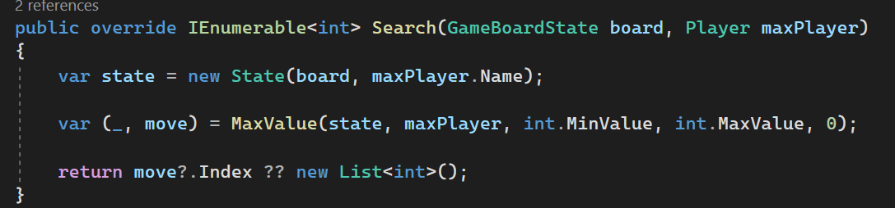
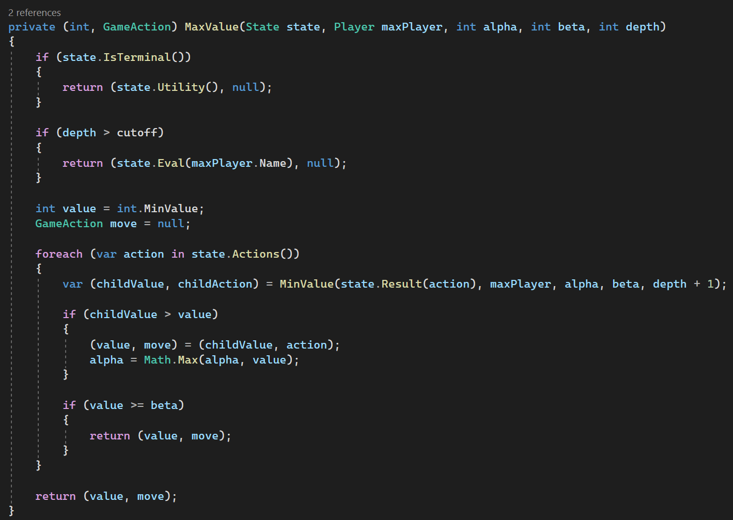
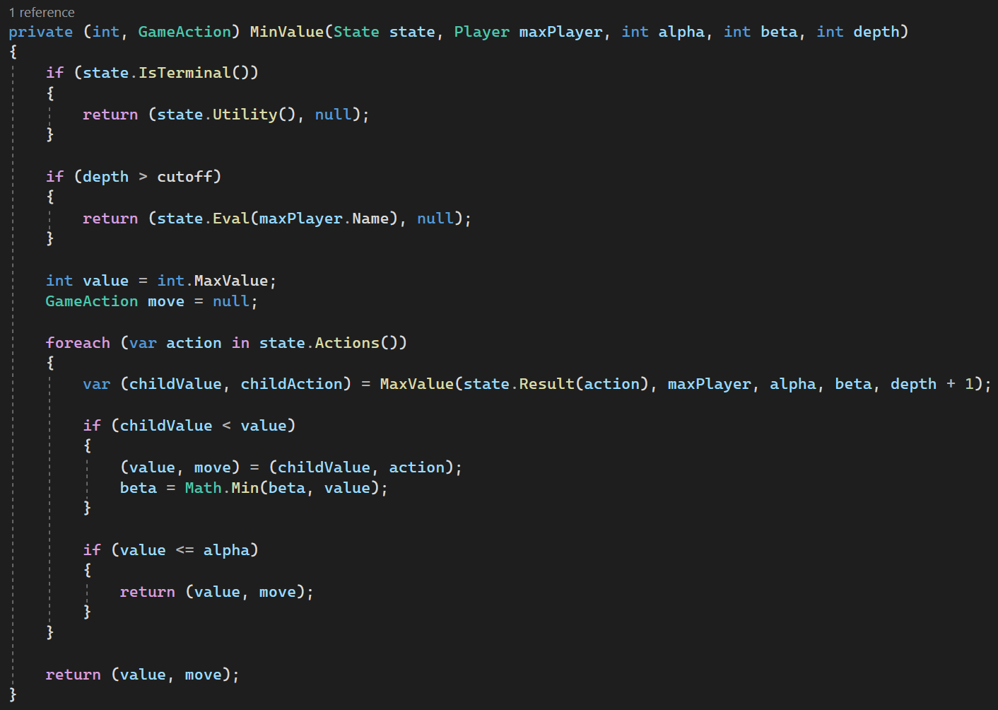
Heuristic Alpha-Beta Tree Search

